Slide 1






DATA ANALYSIS

Slide 2

INTRODUCTION AND OBJECTIVES
Objective:
To identify Country which have potential and is good to open a new restaurant.
Analyzation of rates, cuisines, country ,city , rating, cost to grew up the restaurant which is to open
Introduction:
In a dynamic market, strategic expansion is crucial for sustained growth. This analysis delves into comprehensive data to pinpoint optimal locations, understand market trends, and provide actionable insights for informed decision-making.
Key Components:
Objective assessment of countries and cities for new restaurant openings.
In-depth analysis of factors impacting restaurant success.
Recommendations rooted in data-driven insights

Slide 3

DATA OVERVIEW
Regarding Headings:
Restaurant Identity: Unique Restaurant ID and Name emplace the identification of Restaurant.
Geographical insight: Unique Country code, Country name, position on map by attitude and altitude.
Culinary diversity: An array of cuisiness which will help to attract the customer.
Service provide by restaurant : The restaurant weather takes table reservations and accepts orders online.
Cost consideration: Contains cost of items, ratings of them and average price.
Demand in globally and domestically: Food demand and cost of items all over world.
Service till now: Give a well identification of restaurant that how it withstand on believes of people till present date.

Slide 4

Methodology
Data Cleansing: Thorough cleanup, from city names to format consistency.
Enrichment Strategies: Infusing country descriptions and expanding our dataset.
Analytical Framework: Excel's pivot tables, IF functions, and statistical tools.
Statistical Analysis: Uncovering trends and patterns.
Excel Functions: Pivot tables, LOOKUP, logical operators.
Balanced Precision: Technical insights in accessible language.
Statistical Analysis: Uncovering trends and patterns.
Excel Functions: Pivot tables, LOOKUP, logical operators.
Balanced Precision: Technical insights in accessible language.

Slide 5

ANALYSIS OF OBJECTIVE QUESTION
Data Overview: Explore tables, attributes, and data cleaning steps.
Geographical Insights: Examine restaurant distribution across countries and yearly openings.
Pricing Patterns: Analyze pricing trends and restaurant counts based on price range.
Popularity Metrics: Investigate voter counts and average ratings for key insights.
Conditional Analysis: Explore specific conditions and their impact on restaurant metrics.
Customized Pricing: Understand variations in average cost through customized pricing.
Array Formula Application: Discuss the use of array formulas for complex calculations.

Slide 6

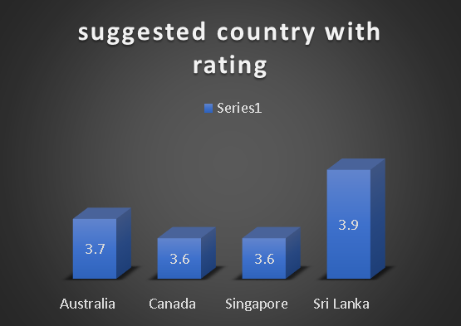








Slide 7







Analytical Approach:
Strategical Insight:

Slide 8



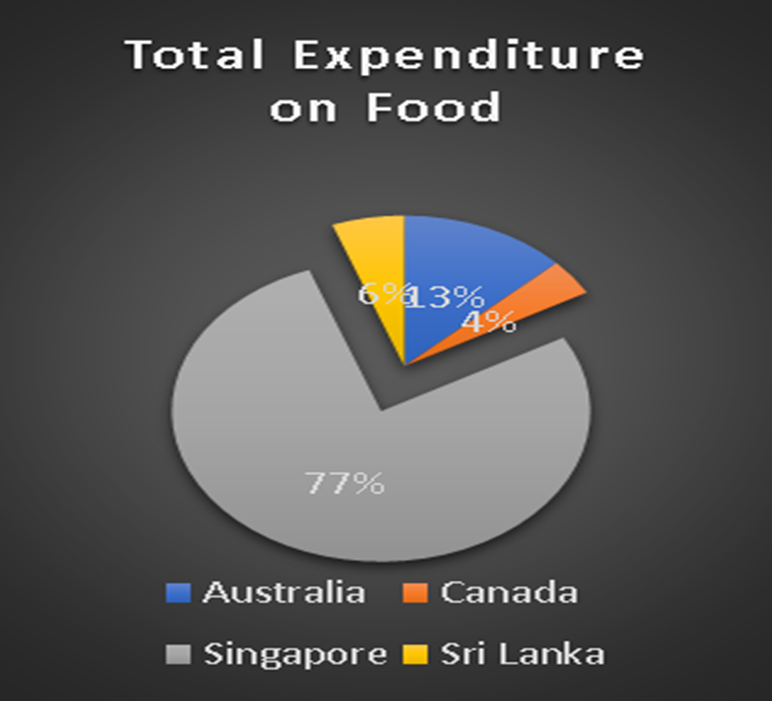



Slide 9







Slide 10




Slide 11
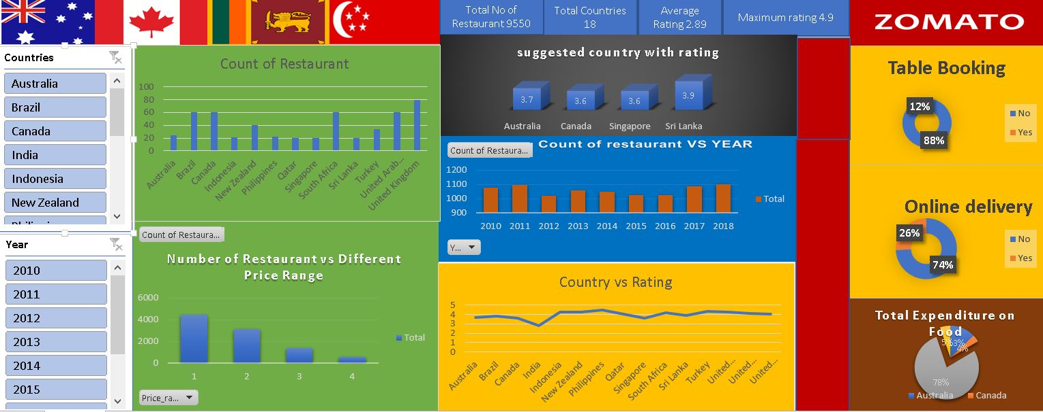
Dashboard
Dashboard

Slide 12


Thank You

